Slide 1


ITEC614 Introduction to Cyber Security
Dr. Farshid Keivanian
Lecturer, Information Technology, PFBS

Slide 2
Risk Assessment and Management
Lecture 5

Slide 3
Previous Lecture…
Have studied…
Symmetric Encryption
Asymmetric Encryption
LFSR
RC4
RSA

Slide 4
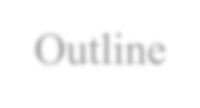
Outline
Trusted computing
Understand the process involved in security management
Detail some alternative approaches to risk assessment
Detail steps required in a formal IT security risk assessment
Characterize identified threats and consequences to determine risk
Detail risk treatment alternatives
STRIDE and DREAD models
Preparation for Assessment 2

Slide 5

Reference
This lecture is based on
Computer Security: Principles and Practices, 4th Ed, William Stallings, 2018
Chapter 14

Slide 6
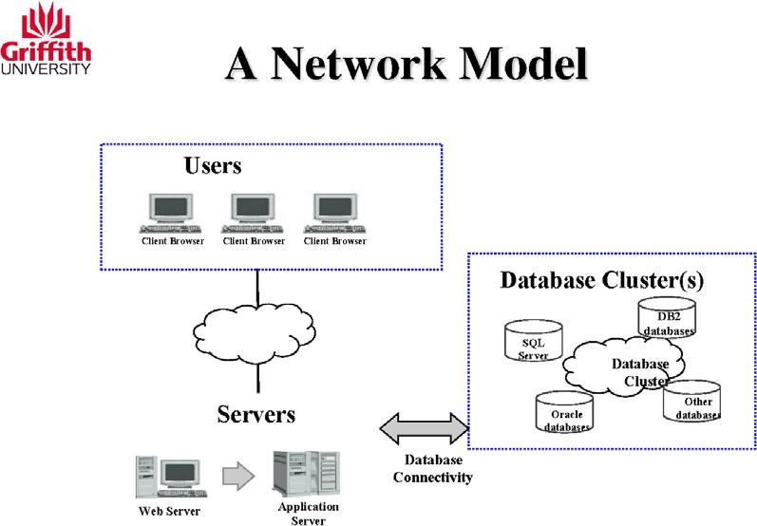
What is a Network Model?
A blueprint showing how users, servers, and databases communicate in an IT system.
Example: A university website where students log in, access course info (web server), and retrieve data from backend systems (application + database servers).

Slide 7
Real-world Example (Australia):
ACU's online systems (like LEO) follow this structure with students as users, web/app servers, and cloud-based databases.

Slide 8
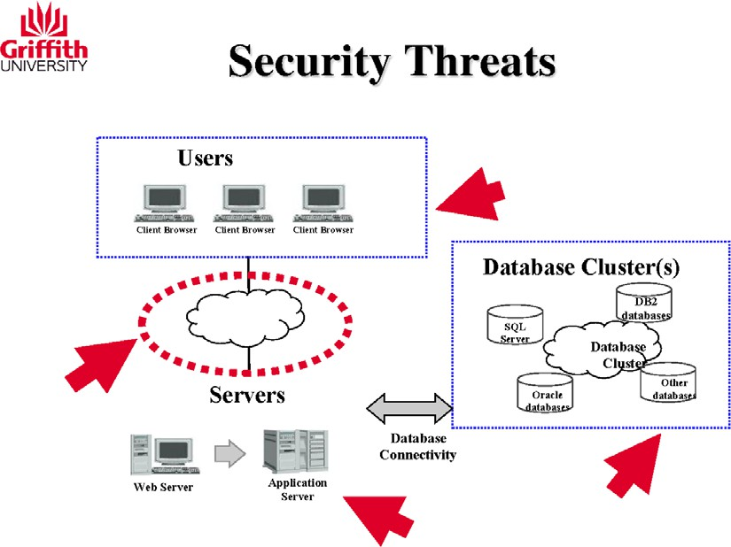
Where can threats happen?
User devices (phishing, malware)
Internet/cloud connections (man-in-the-middle attacks)
Servers (DDoS, server-side injection)
Databases (unauthorised access, SQL injection)

Slide 9
Australian Context:
The 2022 Medibank breach affected healthcare data—highlighting database vulnerabilities.
Tip: Even one weak link can compromise the whole system.

Slide 10
Authentication, Access Control & Wireless Security
Authentication: Verifying who you are (e.g., ACU login using student ID & password)
Access Control: Ensures you can only see what you're authorised to access (e.g., students can't access staff payroll)

Slide 11
Authentication, Access Control & Wireless Security
Wireless Security: Protects Wi-Fi from unauthorised users (e.g., Eduroam network security at Australian campuses)

Slide 12
Authentication, Access Control & Wireless Security
Concept | Example at ACU
Authentication | Logging in with student credentials
Access Control | Only tutors can edit Moodle grades
Wireless Security | Eduroam uses WPA2-Enterprise

Slide 13
Advanced Crypto, SSH & Security Protocols
Advanced Cryptography: Uses complex maths to protect data (e.g., AES encryption in online banking)
SSH (Secure Shell): A secure way to remotely access servers (used by sysadmins at ACU)
Protocols: Rules that secure communication (e.g., HTTPS = secure web browsing)

Slide 14
Advanced Crypto, SSH & Security Protocols
Australian Application:
myGov and ATO systems use encryption and secure protocols to protect tax and Medicare info.

Slide 15
Database Security & Access Control
What is Database Security?
Protects stored data from leaks, unauthorised edits, or loss.
Access Control in Databases:
E.g., student details can be read by admin staff but only edited by authorised registrars.

Slide 16
Database Security & Access Control
In Australia:
Universities must comply with the Privacy Act and store student data securely.

Slide 17
Anomaly Detection & Risk Management
Anomaly Detection:
Spotting unusual activity like a sudden login from a foreign country or massive data download at 2 AM.
Risk Assessment & Management:
Identify, evaluate, and mitigate possible cyber threats.
Example: ACU runs simulations to test system readiness against cyberattacks.

Slide 18
Hands-On Activities
1. Identify Security Risks in an Australian Service Task: Choose a real-world Australian web service (e.g., myGov, ACU Online, Medicare portal) and map out its network model (users, servers, databases). Goal: Highlight 3–5 security threats using red arrows like the diagram. Tool: Use draw.io or PowerPoint.

Slide 19
Hands-On Activities
2. Simulate Secure Data Flow with Wireshark Task: Using Wireshark, simulate HTTP vs HTTPS traffic on a local browser. Goal: Capture a simple login (test form) and demonstrate how encryption protects credentials. Tip: Use https://httpbin.org for testing.

Slide 20
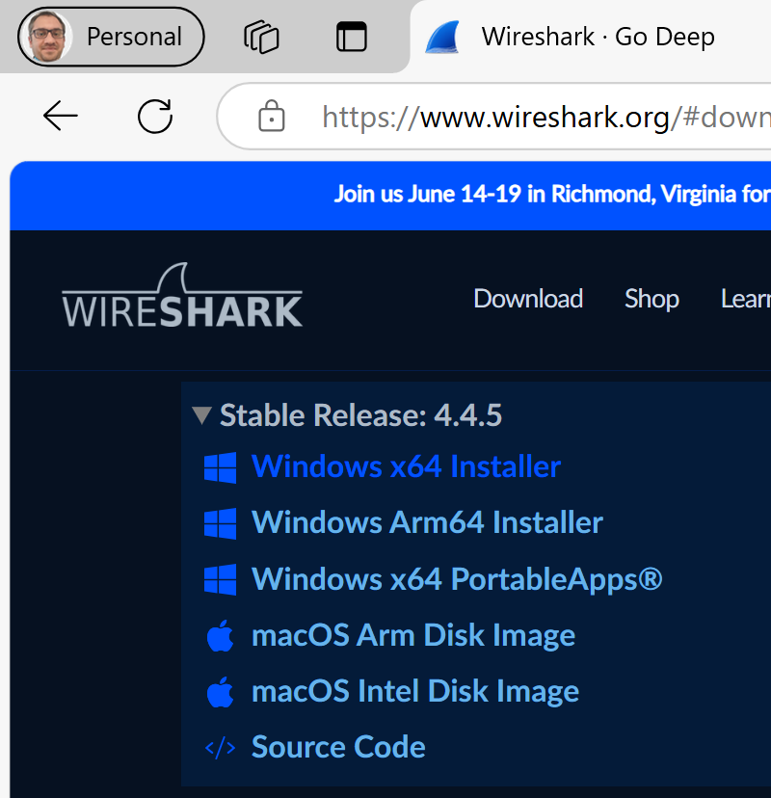
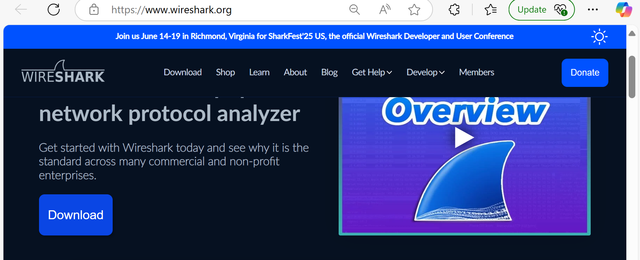
Demonstrating the Power of HTTPS: Secure Data Transmission in Action with Wireshark
Install Wireshark
Download
X-64

Slide 21
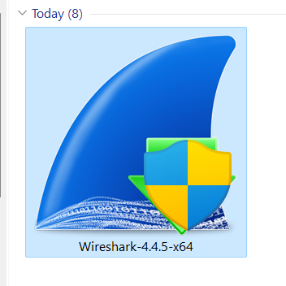
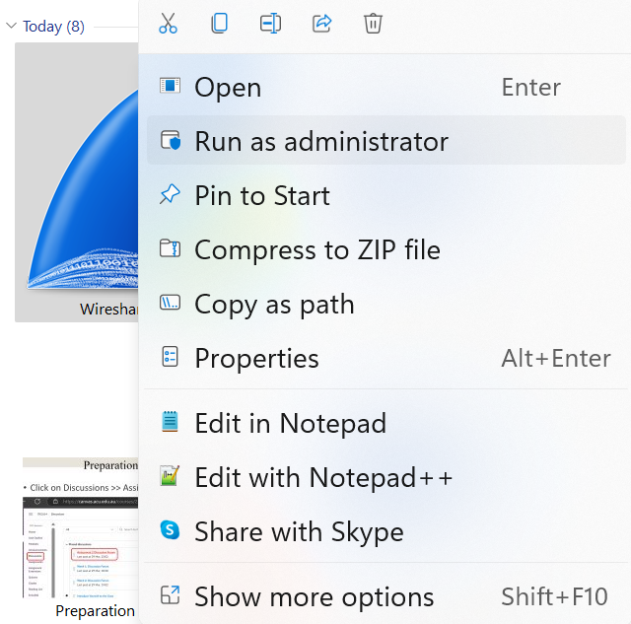
Demonstrating the Power of HTTPS: Secure Data Transmission in Action with Wireshark
Run Wireshark as Administrator

Slide 22
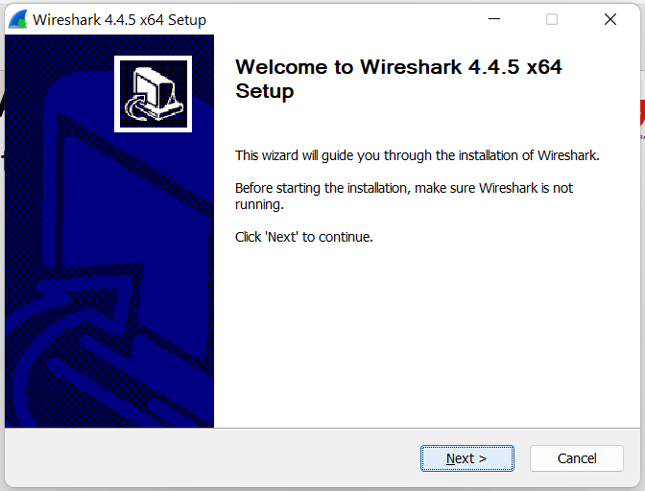
Demonstrating the Power of HTTPS: Secure Data Transmission in Action with Wireshark
Follow installation steps

Slide 23
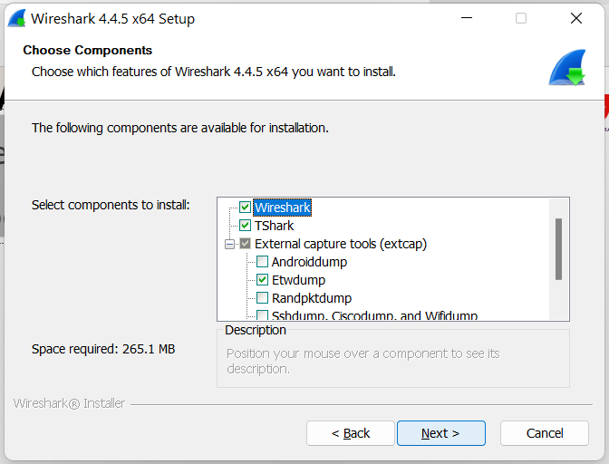
Demonstrating the Power of HTTPS: Secure Data Transmission in Action with Wireshark
Make sure Wireshark and TShark are checked before clicking Next.

Slide 24
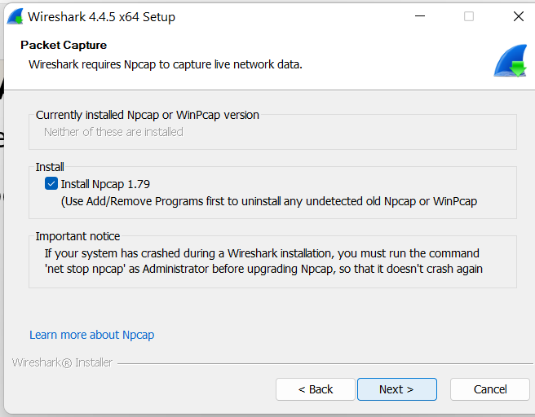
Demonstrating the Power of HTTPS: Secure Data Transmission in Action with Wireshark
Next >> Next …

Slide 25
Demonstrating the Power of HTTPS: Secure Data Transmission in Action with Wireshark
Installation Options
Option | Should You Select It? | Why?
☑ Restrict Npcap driver’s access to Administrators only | √ Yes (Recommended) | Adds extra security so only admins can capture packets (prevents misuse).
☐ Support raw 802.11 traffic (and monitor mode) for wireless adapters | X No (Optional) | Needed only for advanced wireless traffic capture. Not required for HTTP/HTTPS tasks.

Slide 26
Demonstrating the Power of HTTPS: Secure Data Transmission in Action with Wireshark
Installation Options
Option | Should You Select It? | Why?
☐ Install Npcap in WinPcap API-compatible Mode | X No | Only required for legacy software. Wireshark works with the default mode.

Slide 27
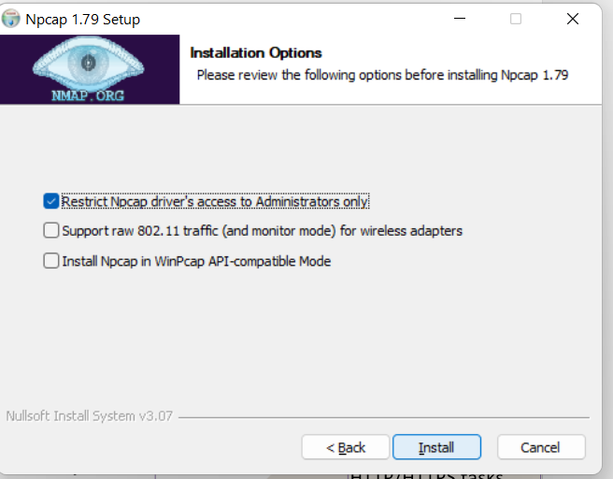
Demonstrating the Power of HTTPS: Secure Data Transmission in Action with Wireshark
Click Install

Slide 28
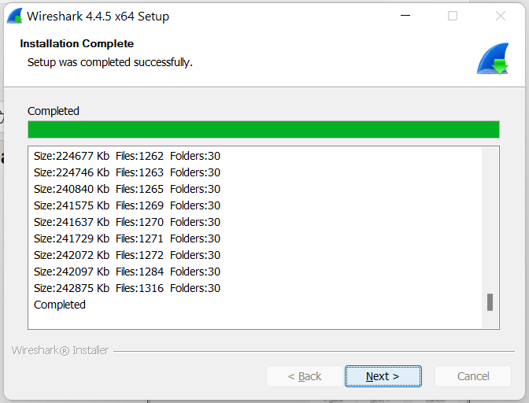
Demonstrating the Power of HTTPS: Secure Data Transmission in Action with Wireshark
Click Next

Slide 29
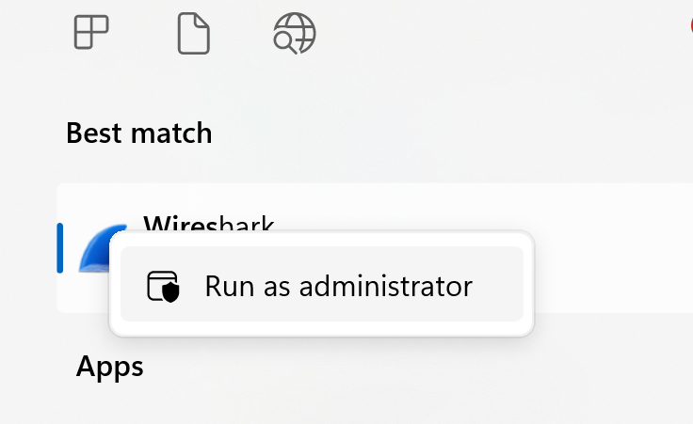
Demonstrating the Power of HTTPS: Secure Data Transmission in Action with Wireshark
Open Wireshark as administrator

Slide 30
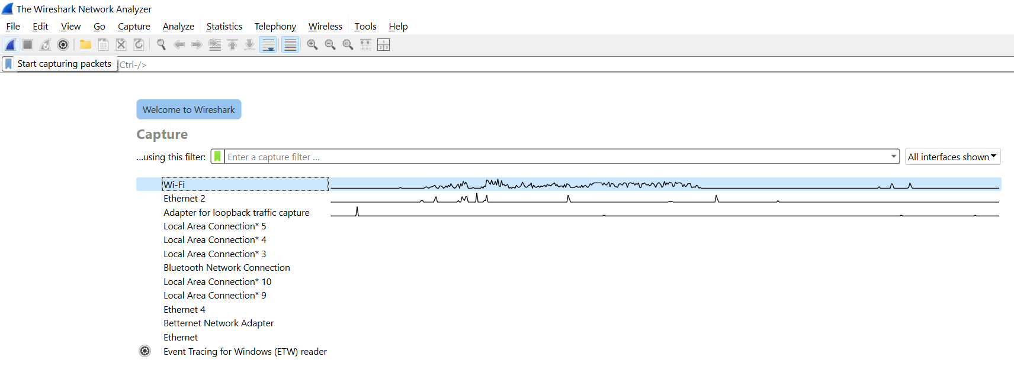
Demonstrating the Power of HTTPS: Secure Data Transmission in Action with Wireshark
Select your active interface (usually the one with traffic spikes). Tip: If you’re using Wi-Fi, click on Wi-Fi.
Click the blue shark fin icon or press Ctrl + E to start capturing.

Slide 31
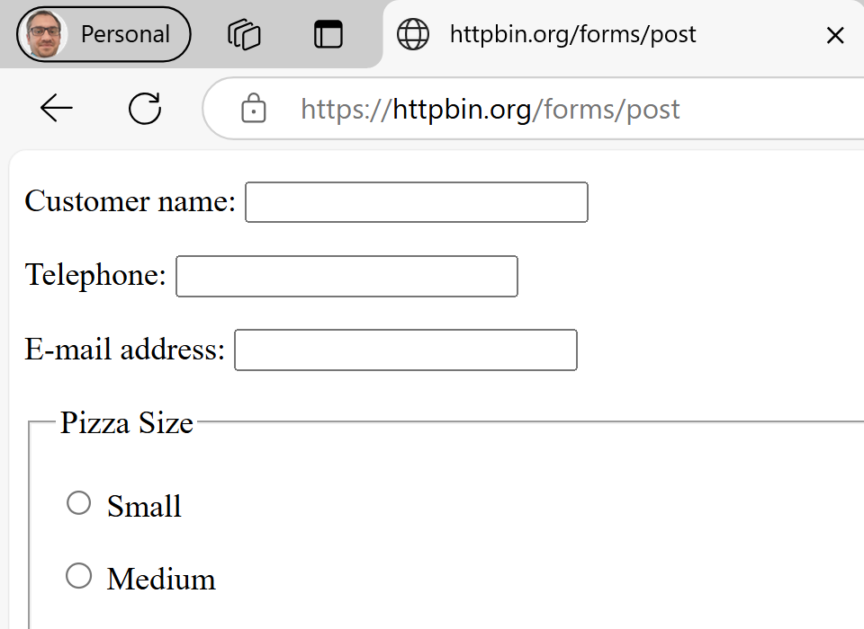
Demonstrating the Power of HTTPS: Secure Data Transmission in Action with Wireshark
2. Visit HTTPS Website
Open your browser and go to: https://httpbin.org
Scroll down to the Forms section, or go directly to: https://httpbin.org/forms/post

Slide 32
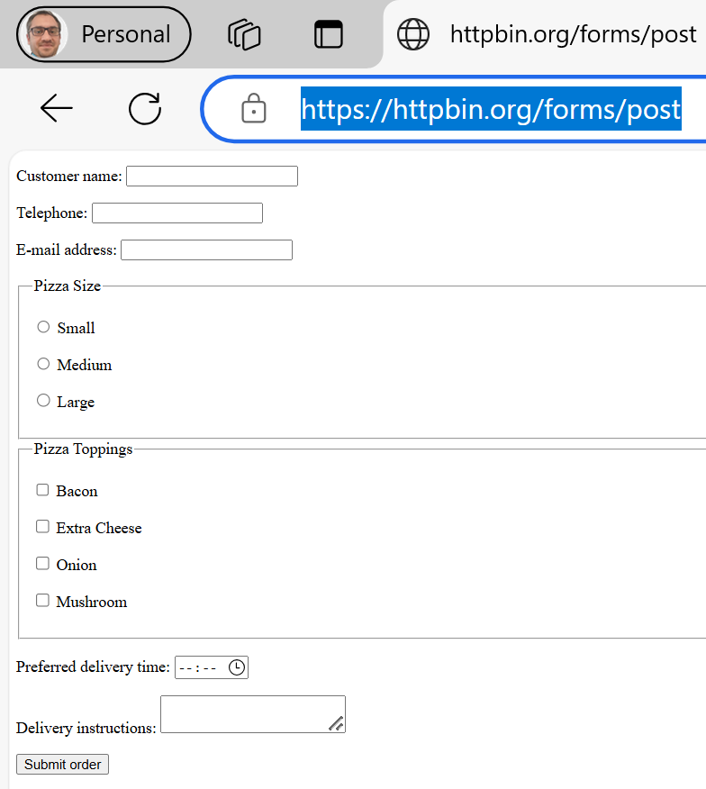
Demonstrating the Power of HTTPS: Secure Data Transmission in Action with Wireshark
3. Submit a Test Form
Fill in fake details:
Name: Farshid
Phone: ….
Email: Farshid@example.com
Choose Pizza size and toppings.
Click Submit order.
This is a secure form (HTTPS) — we’ll use it to simulate secure data flow

Slide 33
Demonstrating the Power of HTTPS: Secure Data Transmission in Action with Wireshark
Privacy: Even though HTTPS encrypts your data in transit, it’s good practice not to use real personal info during simulations.
Security: Prevents potential logging or reuse in external servers.
Teaching Example: Shows students how test data works without risking exposure.

Slide 34
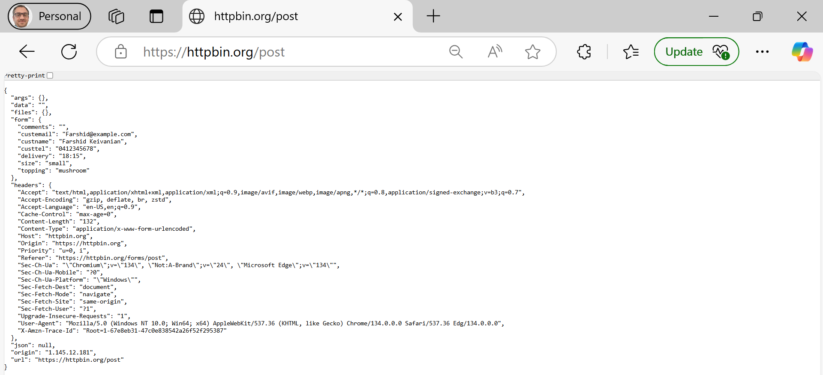
Demonstrating the Power of HTTPS: Secure Data Transmission in Action with Wireshark
This is the expected result page from https://httpbin.org/post which echoes back the POST request you just submitted. It confirms that:
Your form was successfully submitted.
The site received your data.
The data was encrypted in transit via HTTPS, but is decrypted server-side and returned to you for educational/demo purposes.

Slide 35
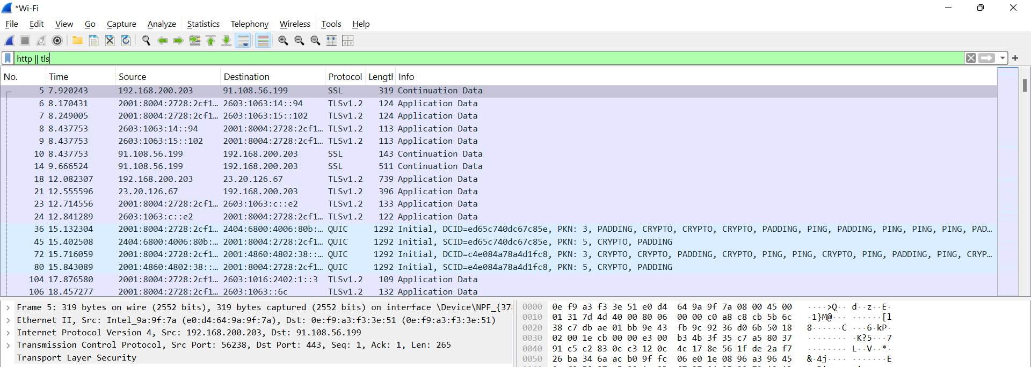
Stop Capture in Wireshark. (Click on Red button)
In the filter bar, type: http || tls

Slide 36
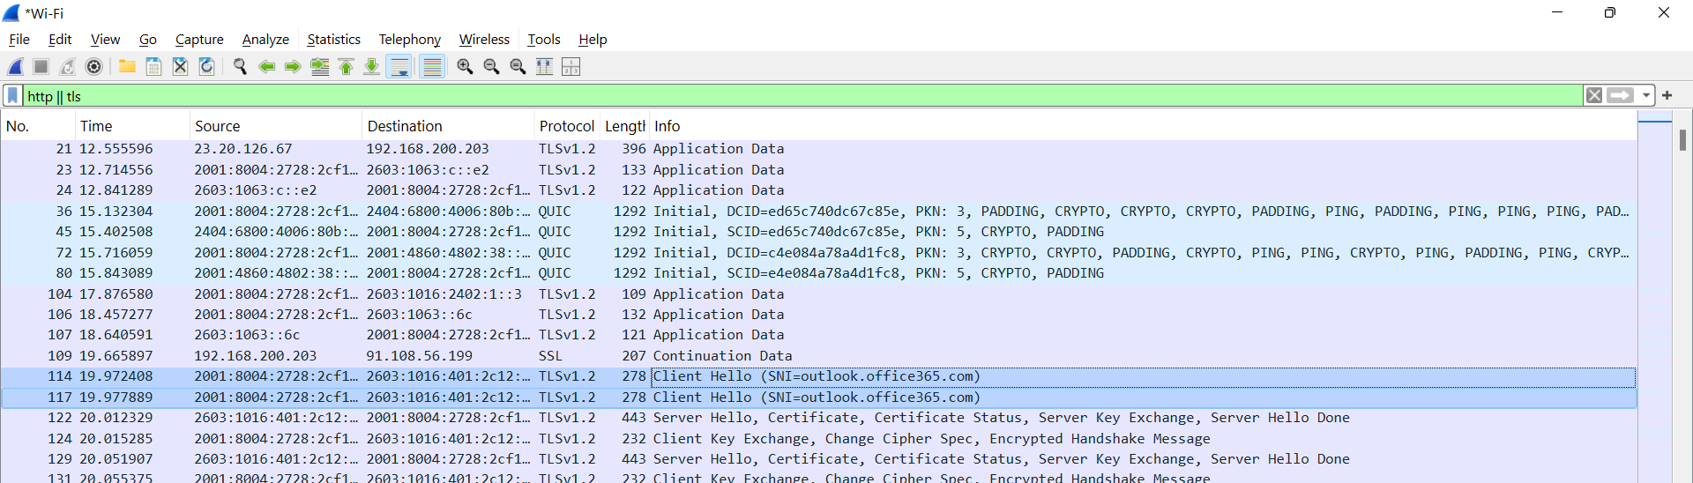
Inspect one of the Client Hello or Encrypted Application Data packets. Look for TLS packets with descriptions like:
Client Hello
Server Hello
Encrypted Application Data

Slide 37
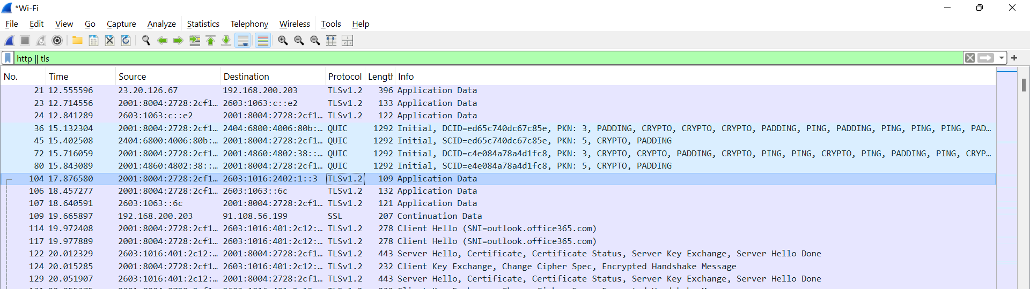
Double Click on any "Application Data" packet (these are encrypted messages) and expand its layers.
You'll notice you can’t see the form data, unlike HTTP — this is because HTTPS encrypts it.

Slide 38
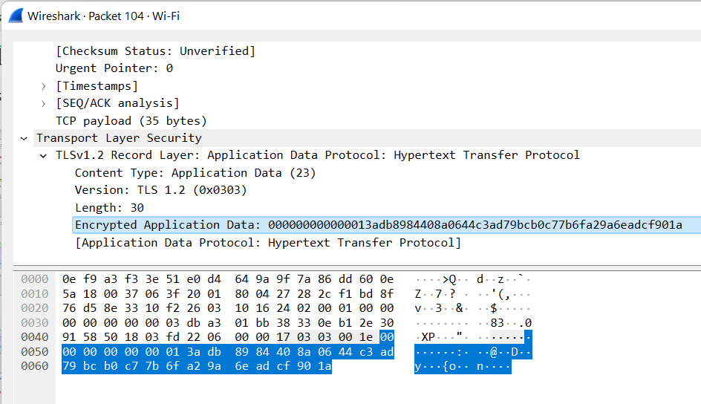
Demonstrating the Power of HTTPS: Secure Data Transmission in Action with Wireshark
Expand Transport Layer Security
Click on TLSv1.2 Record Layer: …
Select Encrypted Application Data
Click on Encrypted Application Data

Slide 39
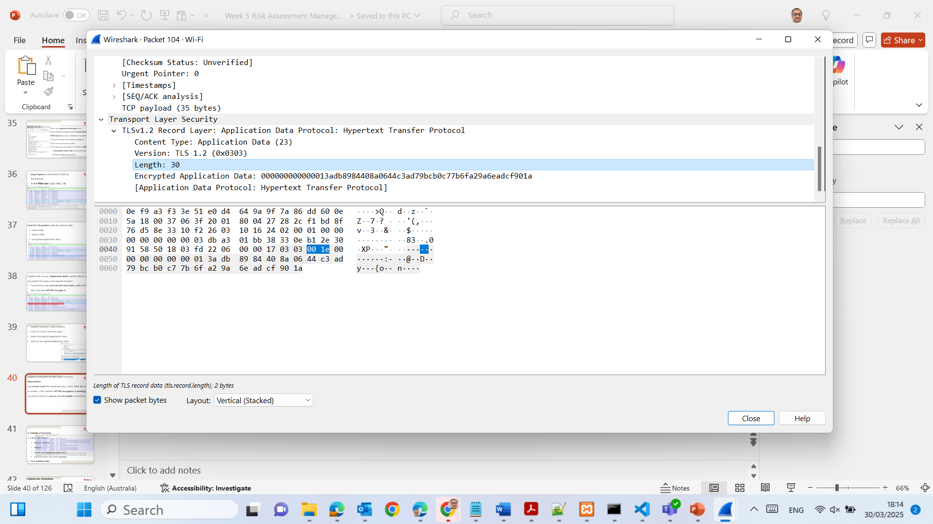
Length of Data (but not the actual content)
Observation:
You cannot read the actual data (e.g., form fields like name or email) — this confirms HTTPS encryption is working. The raw form content is secure and not visible to attackers.

Slide 40
Demonstrating the Power of HTTPS: Secure Data Transmission in Action with Wireshark
Observation: We won’t see the username or password — because HTTPS encrypts it! The actual content is under Encrypted Application Data.

Slide 41
Demonstrating the Power of HTTPS: Secure Data Transmission in Action with Wireshark
The form contents (e.g., our name, email, phone) are not visible — just a string of hexadecimal bytes (e.g., 3adb9894480a8d64...
Conclusion: HTTPS Traffic Is Secure and Encrypted

Slide 42
Demonstrating the Power of HTTPS: Secure Data Transmission in Action with Wireshark
Technical Insight:
Protocol: TLS 1.2
Length: 30 bytes in this packet
Content: Completely encrypted — no plaintext is shown.

Slide 43
What This Proves:
Our login or form data was protected during transmission.
No attacker (even using Wireshark) can read our details without the private encryption key.
This is exactly why HTTPS is essential for secure communication — especially for login, banking, or personal data.

Slide 44
Hands-On Activities
3. Access Control Scenario (Role-Based) Task: In small groups, assign roles: Student, Lecturer, IT Admin. Goal: Define what each role can access in ACU’s learning platform (LEO), then map this in a basic access control table.

Slide 45
Hands-On Activities
Role | Access to Student Grades | Access to Server Logs | Upload Assignments
Student | X | X
Lecturer |  | X
IT Admin |  |  | X

Slide 46
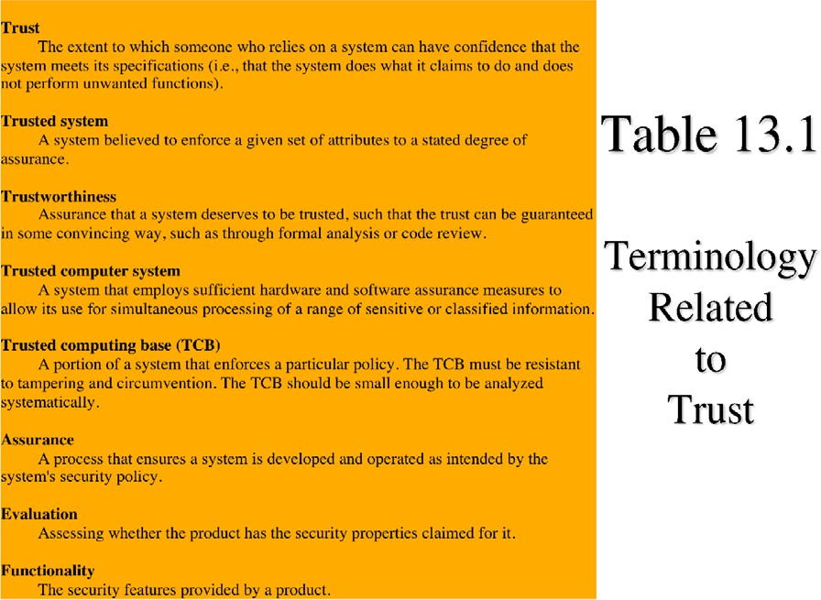

Slide 47
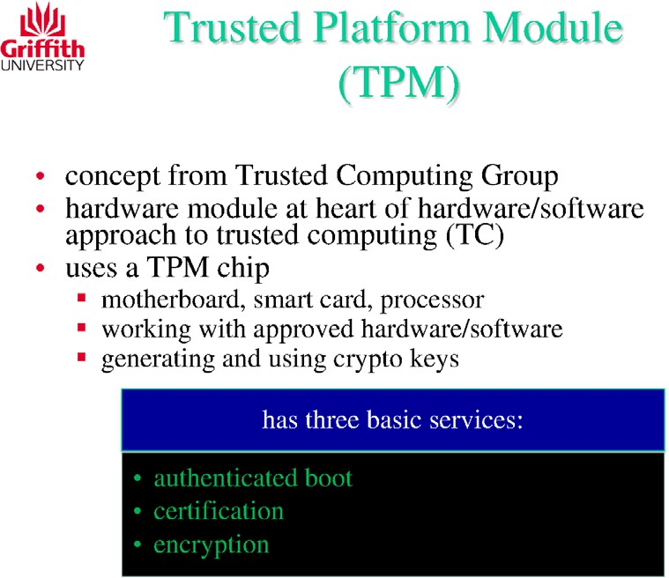
What is a Trusted Platform Module (TPM)?
Think of a TPM as a tiny security guard chip built into your computer. It helps keep your system safe, especially at startup.

Slide 48
It’s created by a group called the Trusted Computing Group.
It’s a hardware-based security module — built into your motherboard, smart card, or processor.
It only works with trusted (approved) software or hardware.
It generates and stores cryptographic keys securely — these keys are used for encryption and other security tasks.

Slide 49
TPM provides 3 main security services:
Service | What it means in plain English
Authenticated Boot | Checks if the system hasn’t been tampered with before it starts.
Certification | Verifies the system is genuine and secure.
Encryption | Protects your data by locking it with a secure key.

Slide 50
Example:
Windows 11 requires TPM 2.0 to run — it’s one of the ways Microsoft ensures devices are secure.

Slide 51
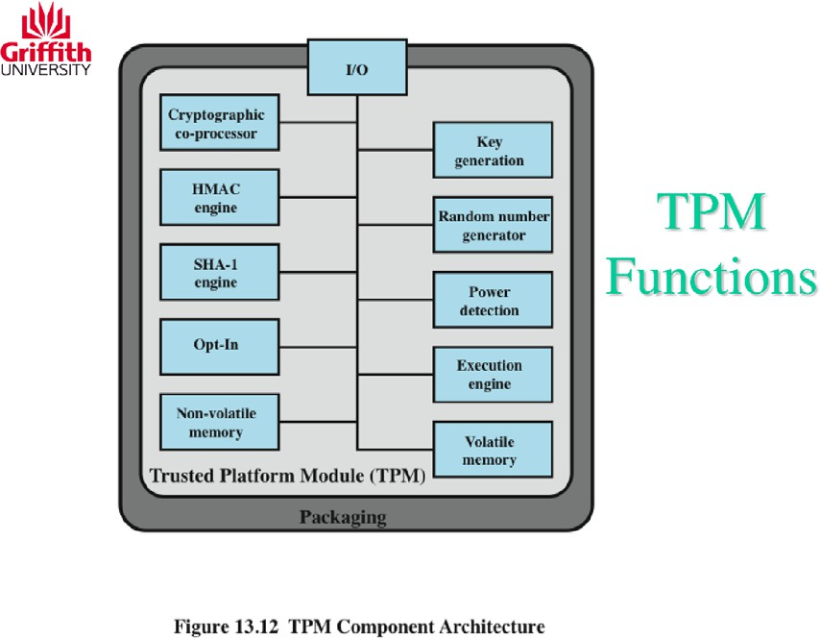
TPM Functions – What’s Inside the Security Chip
Let’s look inside the Trusted Platform Module (TPM) — it’s not just one thing, but a mini security toolbox built into your computer.
Think of it like a smart security assistant that does multiple jobs to protect your system.

Slide 52
Key TPM Components & What They Do
Component | What It Does (Plain English)
Cryptographic Co-Processor | Handles complex encryption tasks.
HMAC Engine | Checks if your data has been changed (integrity check).
SHA-1 Engine | Generates secure hashes (fingerprints of data).
Opt-In | Allows users to enable/disable TPM features.

Slide 53
Key TPM Components & What They Do
Component | What It Does (Plain English)
Non-Volatile Memory | Saves keys/settings even when power is off.
Key Generation | Creates new secure encryption keys.
Random Number Generator | Generates unpredictable numbers (vital for encryption).
Power Detection | Detects tampering during boot or shutdown.

Slide 54
Key TPM Components & What They Do
Component | What It Does (Plain English)
Execution Engine | Runs internal secure processes.
Volatile Memory | Temporary memory used during TPM operations.
I/O | Connects TPM to the rest of the system.

Slide 55
Why it matters:
All these parts work together to make sure your computer starts safely, keeps your data secure, and detects tampering.

Slide 56
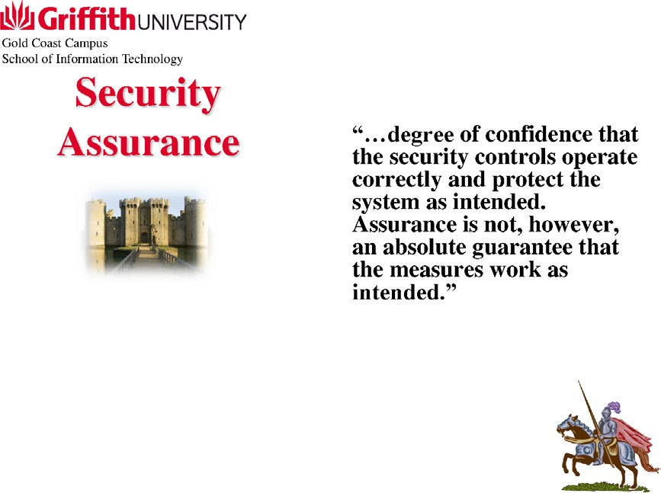
What Is Security Assurance?
Security assurance means how confident we are that the security features in a system are actually working. It doesn’t guarantee 100% protection, but it shows that everything is functioning as expected to keep systems safe.

Slide 57
What Is Security Assurance?
Think of it like a castle with guards and gates — we trust the protection based on what’s in place, but we still keep checking and testing to be sure it's doing the job.

Slide 58
Who Needs Assurance and Why?
Audience | What They Do
Consumers | Pick the security features and decide how much assurance is enough (e.g., schools, banks in Australia).
Developers | Build the system securely and explain how secure it is.
Evaluators | Review if everything meets assurance levels (can be internal or third-party).

Slide 59
Where Security Assurance Applies:
Security assurance is applied in:
Security requirements (e.g., passwords, encryption)
Security policies (rules)
Product design (how it’s built)
Implementation (how it's deployed)
System operation (daily usage)

Slide 60
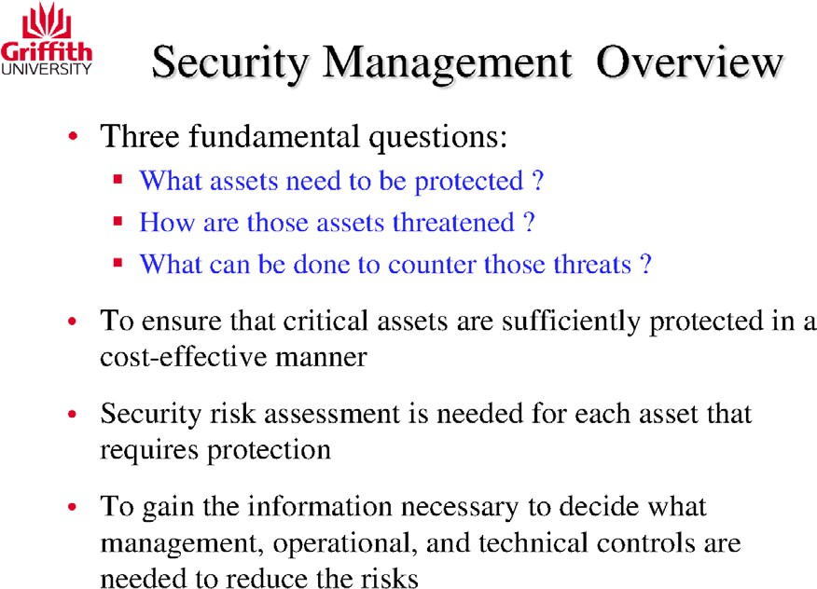

Slide 61
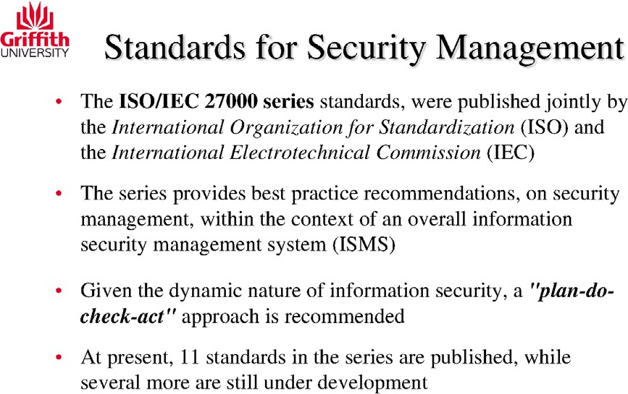

Slide 62
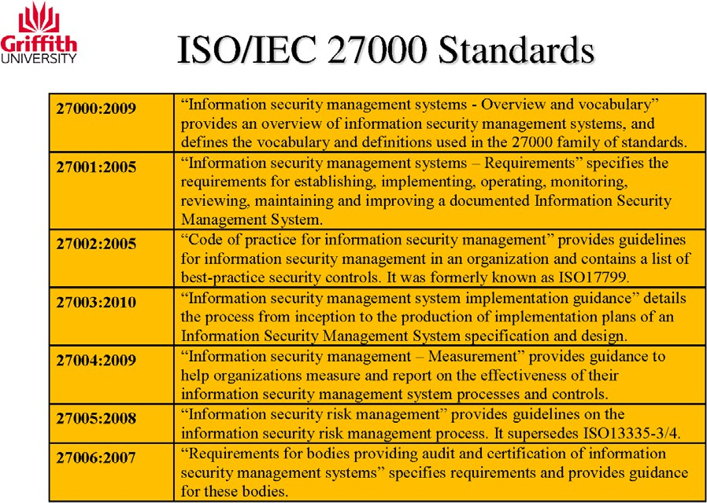

Slide 63
ISO/IEC 27001 in an Australian University
Let’s say Australian Catholic University (ACU) wants to secure its student data, research files, and email communications.

Slide 64
How ISO/IEC 27001 helps:
This standard helps ACU:
Define clear rules and responsibilities for data access.
Create a policy to protect student records and emails.
Implement encryption, password controls, and two-factor authentication (e.g., for student portals like MyACU).
Perform risk assessments regularly – for example, checking if staff emails are vulnerable to phishing.
Continuously monitor and improve – like updating anti-malware tools or refining cybersecurity awareness training.

Slide 65
How ISO/IEC 27001 helps:
Benefit: If ACU follows ISO/IEC 27001:
Students and staff can trust the university’s systems.
It protects the university’s reputation.
It supports compliance with Australia’s Privacy Act 1988.

Slide 66
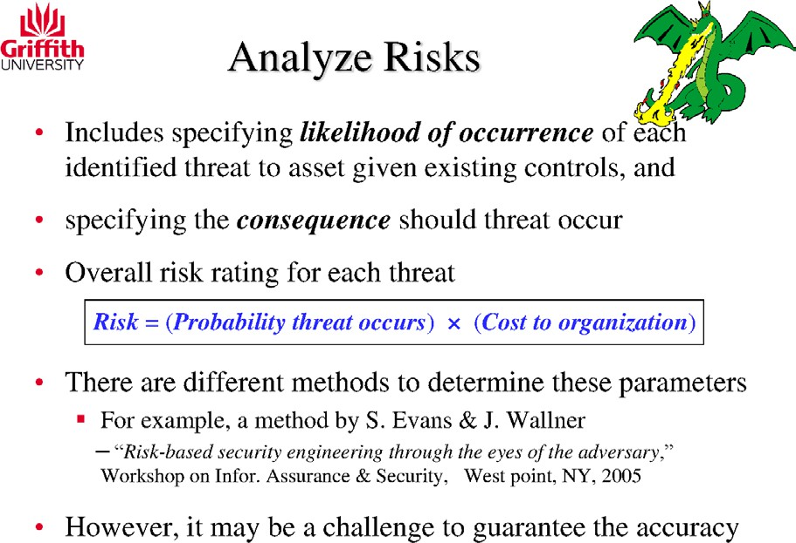
Risk Analysis at an Australian University
Scenario: Let’s say the library system at Australian Catholic University (ACU) stores personal student data, including ID numbers and borrowing history.

Slide 67
Risk Analysis at an Australian University
Identified Threat: A hacker tries to break into the system via a phishing email to library staff.

Slide 68
Risk Analysis at an Australian University
Step-by-step Risk Analysis:
Component | Value (Hypothetical)
Likelihood of attack | 30% chance (staff might fall for phishing without training) = 0.3
Impact (cost to uni) | Estimated cost = $150,000 (data breach, legal fees, notifications)
Risk = Likelihood × Cost | 0.3 × $150,000 = $45,000 risk value

Slide 69
Risk Analysis at an Australian University
Conclusion: This calculated risk value ($45,000) helps ACU prioritise where to invest — for example, giving staff cybersecurity training to lower the likelihood.

Slide 70
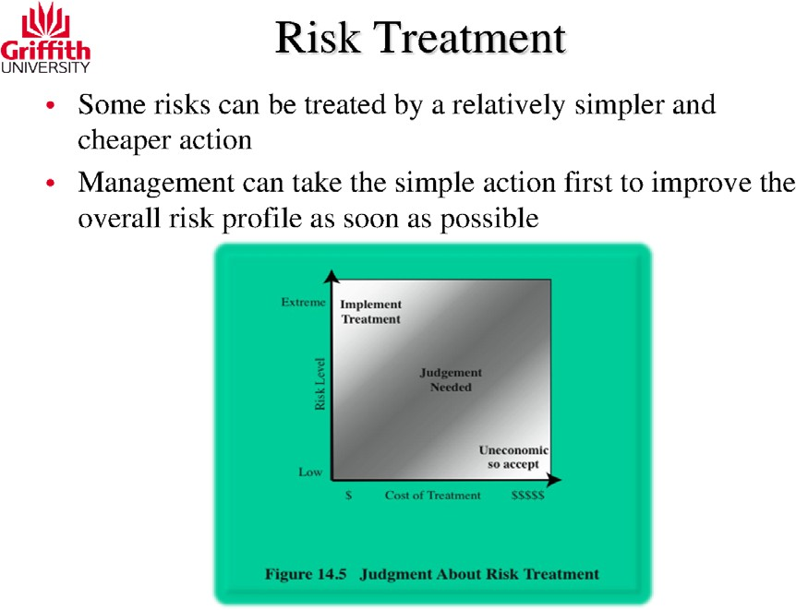
Example: Cyber Risk Treatment in a Small Business
Scenario: A small business stores customer data but doesn’t have multi-factor authentication (MFA) enabled for employee logins.

Slide 71
Example: Cyber Risk Treatment in a Small Business
Risk Analysis:
Risk Level: Medium (possible hacker access)
Treatment Cost: Low (MFA setup is often free with services like Google or Microsoft)

Slide 72
Example: Cyber Risk Treatment in a Small Business
Decision Using the Diagram Logic:
Low cost + Medium risk = ✔️ "Implement Treatment"
It’s easy and cheap, so the business should act quickly to improve security.

Slide 73

STRIDE Model
Spoofing Identity
Tempering with data
Repudiation
Information Disclosure
Denial of Service (DoS)
Elevation of Privilege
Shostack, A. (2014).Threat modeling: Designing for security. John Wiley & Sons

Slide 74
What is STRIDE?
When designing or reviewing a system, we need to think about the types of security threats it could face. STRIDE is a model used to categorise threats into six main areas:
S – Spoofing T – Tampering R – Repudiation I – Information Disclosure D – Denial of Service (DoS) E – Elevation of Privilege

Slide 75
STRIDE at a Glance (Comparison Table)
STRIDE Category | What It Means | Example (Australia)
Spoofing | Pretending to be someone else | Using another student's login ID to access results
Tampering | Changing data illegally | Editing hospital patient data without permission
Repudiation | Denying an action without evidence | Claiming you didn’t submit an assignment (no logs recorded)

Slide 76
STRIDE Category | What It Means | Example (Australia)
Information Disclosure | Viewing data you're not allowed to see | Seeing others’ tax or Medicare details via a system glitch
Denial of Service | Making a system unavailable | Overloading a university website before enrolment deadline
Elevation of Privilege | Gaining admin rights without authorisation | A café worker accessing Centrelink admin portal as a hacker

Slide 77
Real-World Threat Scenarios (Based on STRIDE)
Scenario 1 – Spoofing A hacker fakes a myGov login and gets access to sensitive documents.
Scenario 2 – Tampering An insider at a logistics company changes parcel delivery records.

Slide 78
Real-World Threat Scenarios (Based on STRIDE)
Scenario 3 – DoS Attack A DDoS attack takes down an online ticket system before a concert in Sydney.

Slide 79
How to Apply STRIDE
Break your system into components (e.g., database, user interface, API).
Look at each and ask: "Can this be spoofed? Tampered with? Disclosed?“
Make a list of potential threats in each STRIDE category.
This helps design better security controls early.

Slide 80
Applying STRIDE to a Shopping Website: Real-Life Threat Examples
For a shopping website:
Login system → Spoofing
Checkout process → Tampering
Database → Information disclosure
Payment service → DoS & Elevation of privilege

Slide 81
Research Discussion Questions
Which STRIDE category do you think is the most dangerous in e-commerce websites? Why?
Can a single attack fall under more than one STRIDE category? Give an example.
How would repudiation be handled in a cloud-based system?
What Australian legal or ethical considerations apply to information disclosure?

Slide 82
Hands-On Activities
Activity 1: STRIDE Breakdown
Choose any common Australian app or website (e.g., Service NSW, myGov, Medicare, or MyACU).
In small groups, map each STRIDE category to a potential threat in the app.
Present findings in 3 mins.

Slide 83
Hands-On Activities
Sample Response – STRIDE Breakdown for Service NSW
STRIDE Category | Threat Example on Service NSW Website
Spoofing | An attacker creates a fake Service NSW login page to steal users' credentials (phishing attack).
Tampering | A hacker intercepts a registration form and modifies data (e.g. changing a car’s rego expiry date).

Slide 84
Hands-On Activities
Sample Response – STRIDE Breakdown for Service NSW
STRIDE Category | Threat Example on Service NSW Website
Repudiation | A user denies having changed their address or license details, and the system lacks logging to prove it.
Information Disclosure | Personal details like Medicare, license, or rego history are leaked due to poor access control.

Slide 85
Hands-On Activities
Sample Response – STRIDE Breakdown for Service NSW
STRIDE Category | Threat Example on Service NSW Website
Denial of Service | A botnet floods the Service NSW site during peak renewal time, making it unavailable to legitimate users.
Elevation of Privilege | A regular user finds a vulnerability that gives them admin-level access to citizen records.

Slide 86
Hands-On Activities
Activity 2: Threat Simulation Discussion
You’re a cyber team at an Australian university.
A student logs in with someone else’s credentials and downloads data.
Identify:
Which STRIDE categories are involved?
What security could prevent this?

Slide 87
Hands-On Activities
Activity 3: STRIDE Risk Ranking
List 6 potential threats in a small business in Australia (like a medical clinic or law firm).
Categorise them under STRIDE.
Rank them from low to critical risk and explain why.

Slide 88

DREAD Model
Damage- how bad would an attack be?
Reproducibility- how easy it is to reproduce the attack?
Exploitability- how much work is required to launch an attack?
Affected Users- the number of people that will be affected
Discoverability- how easy is it to discover the vulnerability?

Slide 89
What is the DREAD Model?
The DREAD model helps us rate how dangerous a cyber threat is. Each letter stands for something we can measure. We score each one (e.g. from 1 to 10), then add them up to get a risk level.

Slide 90
DREAD Breakdown (with Aussie Examples)
DREAD Category | Question | Example (Australia)
Damage | How bad could it be? | Hackers delete patient records in a NSW Health database
Reproducibility | Can it be repeated easily? | If the attack method is shared on forums, others can repeat it quickly

Slide 91
DREAD Breakdown (with Aussie Examples)
DREAD Category | Question | Example (Australia)
Exploitability | How easy is it to launch the attack? | Just using public Wi-Fi to sniff Service NSW login packets
Affected Users | How many people will it impact? | An attack on MyGov could affect millions of Australians

Slide 92
DREAD Breakdown (with Aussie Examples)
DREAD Category | Question | Example (Australia)
Discoverability | How easy is it to find the vulnerability? | A bug in the Medicare app login screen might be obvious to any user

Slide 93
Example DREAD Score – Service NSW Login Vulnerability
Category | Score (1–10) | Why?
Damage | 8 | May expose driver license or address info
Reproducibility | 6 | Scripted attack can be reused
Exploitability | 7 | Weak session token makes hijacking easy

Slide 94
Example DREAD Score – Service NSW Login Vulnerability
Category | Score (1–10) | Why?
Affected Users | 9 | Many users log in to renew licenses
Discoverability | 5 | Could be noticed by pen-testers or curious users
Total Score | 35/50 | → High Risk

Slide 95
Research Discussion Questions
Which DREAD category do you think matters the most in real-world Australian systems? Why?
Can you think of a real data breach in Australia where Discoverability was high?
Why is it important to quantify risk instead of just guessing it?

Slide 96
Hands-On Activities
Activity 1: Rate a Threat
Pick a recent Australian cyber incident (e.g. Medibank, Optus).
In pairs, rate it using the DREAD model.
Present the scores and justify your reasoning.

Slide 97
Hands-On Activities
Activity 2: Compare Two Systems
Group 1: Rate a university system (e.g. student portal).
Group 2: Rate a government portal (e.g. Service NSW).
Discuss: Which one has higher DREAD risk and why?

Slide 98
Hands-On Activities
Activity 3: Create a DREAD Risk Table
Choose a made-up app (e.g. online voting, e-commerce, or transport booking).
List 3 threats and assign DREAD scores to each.
Rank the threats from highest to lowest risk.

Slide 99
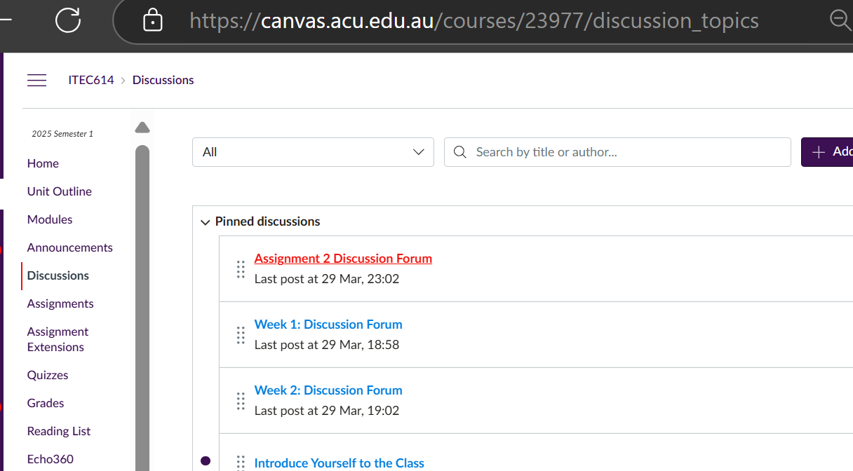
Preparation for Assessment 2
Click on Discussions >> Assignment 2 Discussion Forum

Slide 100
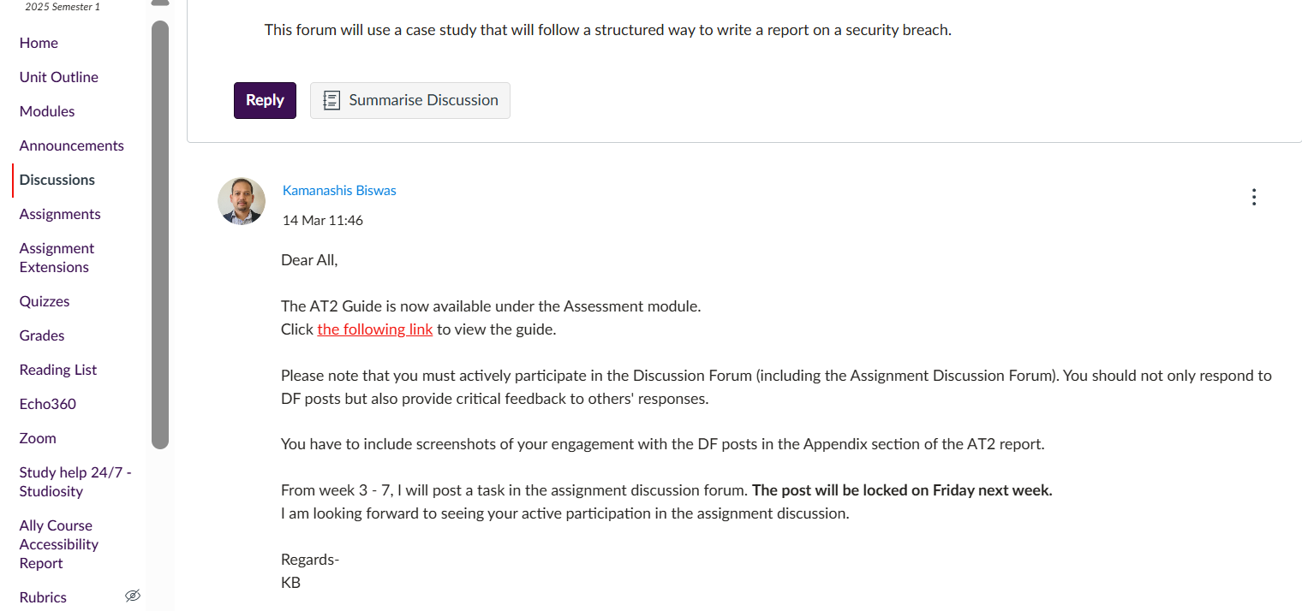
Preparation for Assessment 2
Guideline

Slide 101
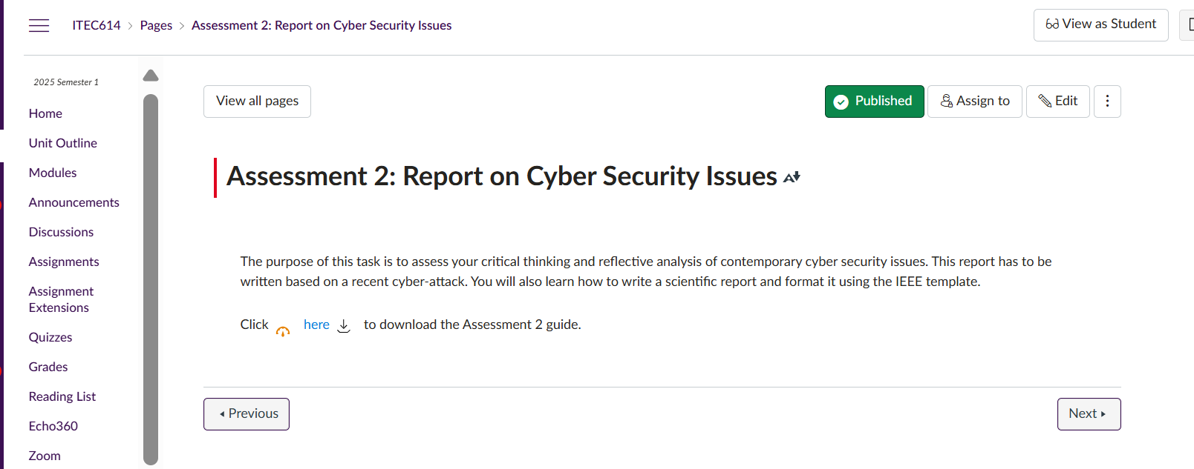
Preparation for Assessment 2
Assessment Guide

Slide 102
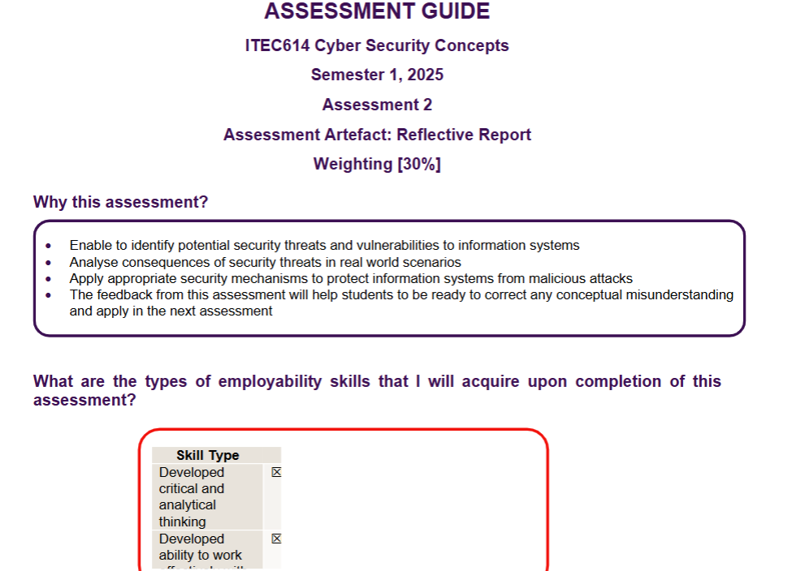
Preparation for Assessment 2
Assessment Guide

Slide 103
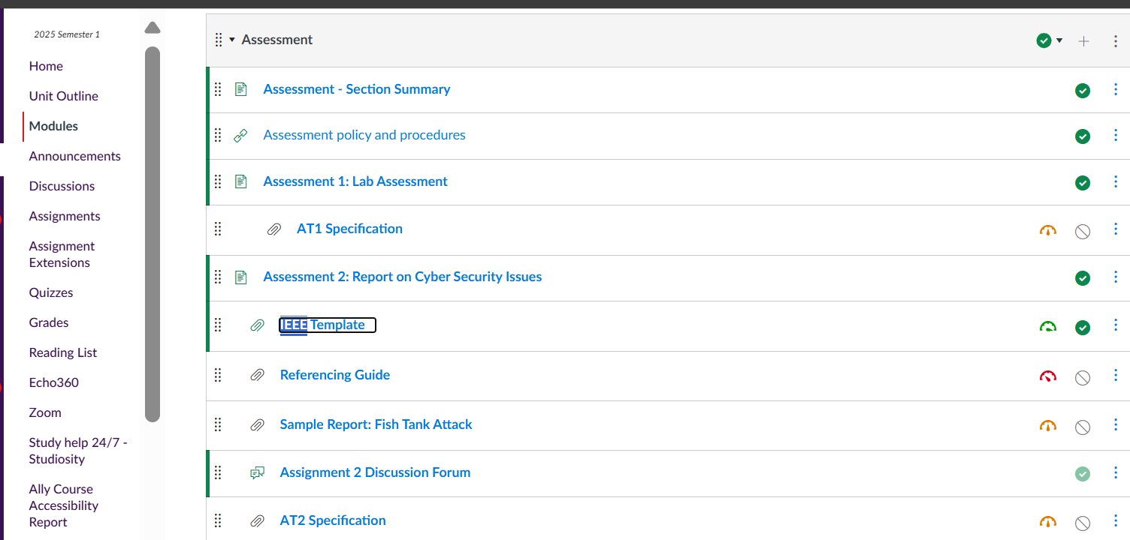
Preparation for Assessment 2
IEEE Template

Slide 104
Preparation for Assessment 2
Referencing Guide

Slide 105
What Are You Supposed to Do?
You will write a group reflective report on a real-world cyber security breach (e.g., Casino Fish Tank Hack or any 2025 incident from the Webber list) using:
MITRE ATT&CK framework: https://attack.mitre.org
IEEE format template (provided on Canvas)
Weekly Discussion Forum contributions (Week 3 to Week 8)
Include screenshots of your forum participation in your Appendix

Slide 106
Breakdown of What to Do Each Week (Weeks 3 to 8)
Week | Task | Where to Submit | Tips
3 | Write Introduction to your report | Week 3 AT2 Discussion Forum | Use the fish tank case or your chosen breach. Highlight the incident’s background and importance.
4 | Describe the Details of the Breach | Week 4 Forum | Use MITRE ATT&CK to explain hacker techniques. Mention any vulnerabilities or company oversights.

Slide 107
Breakdown of What to Do Each Week (Weeks 3 to 8)
Week | Task | Where to Submit | Tips
5 | Discuss the Existing Security Controls in Place | Week 5 Forum | Identify what was missing or outdated. Any existing firewalls? Network monitoring?
6 | Propose Improved Security Mechanisms | Week 6 Forum | Recommend defenses based on MITRE. Justify each.

Slide 108
Breakdown of What to Do Each Week (Weeks 3 to 8)
Week | Task | Where to Submit | Tips
7 | Draft your Conclusion | Week 7 Forum | Summarize lessons learned, critical insights, and future protections.
8 | Compile Your Full Report and Share it in the Forum | Week 8 Forum + Turnitin | Paste full IEEE report in Week 8 forum. Submit to Turnitin. Include Appendix with DF post screenshots.

Slide 109
Final Report Structure (IEEE Template)
Feed Forward Template (Appendix I)
Checklist (Appendix II)
Abstract (100–200 words): Summarize the case, causes, findings, and controls.
Introduction: Context of the breach and report purpose.
Details of Breach Causes: Use MITRE tactics and techniques observed.
Critical Security Controls: Suggest new or improved defenses.
Conclusion: Final remarks, major takeaways.
References (IEEE style – at least 5 scholarly sources)
Appendix: Screenshots of all DF posts by both members with timestamps.

Slide 110
How to Stand Out
Rubric)
Area | How to Excel
Critical Thinking (GC1) | Provide deep analysis with justification and evidence for each argument.
Real-World Connection (GC2) | Directly link theories to the breach scenario. Use examples from the attack.
Team Collaboration (GC4) | Show balanced input from both members and interaction with others in forums.

Slide 111
How to Stand Out
Rubric)
Area | How to Excel
Evaluation (GC7) | Consider attacker tactics, system flaws, and industry practices from multiple views.
Innovation (GC8) | Propose new or advanced controls aligned with MITRE. Go beyond surface-level fixes.
Formatting & Referencing | Follow the IEEE paper format strictly. Use the correct IEEE in-text citations and list format.

Slide 112
What to Avoid
X Mistake | Why Avoid It
Submitting late | 5% penalty per day, 0 after 3 days
Ignoring forum participation | Zero marks for collaboration section
Missing screenshots in appendix | Evidence of DF activity is compulsory
d

Slide 113
What to Avoid
X Mistake | Why Avoid It
No citations or wrong format | May be flagged for plagiarism
Choosing outdated or vague case | Choose from the approved list (2025 breaches or fish tank hack)
d

Slide 114
Resources
MITRE ATT&CK Framework
[IEEE Template (on Canvas)](Canvas site link)
Fish Tank Hack Article (Forbes)
Webber Insurance Breach List
[Referencing Guide – IEEE Style](Canvas site or class resource)
d

Slide 115
Need Help?
Post in Canvas Discussion Forum
Contact your Lecturer: Farshid.Keivanian@acu.edu.au
Book a session with Academic Skills Unit (ASU)
d

Slide 116
Dear …,
I hope you are doing well.
I have a few questions regarding Assessment 2:
1. Is this a group-based assessment? If so, how many members should be in each group?
2. I would like to ask these questions to the campus lecturer, but I don’t have their contact details. Could you kindly provide them if possible?
3. You mentioned that from Week 3 to Week 8, we need to submit discussion forum posts related to Assessment 2. However, I am unsure about the specific topics we need to cover each week (e.g., introduction, etc.). If there is a PDF or document outlining the weekly discussion topics, could you please share it with us? It would help us follow the correct order and structure.
Thank you very much for your time and guidance.
Best regards,
d

Slide 117
I hope you’re doing well.
Thanks for your questions, and I understand that Assessment 2 can seem a bit complex at first — I’m happy to clarify further:
d

Slide 118
Group Size: Yes, Assessment 2 is a group assessment, and each group can have a maximum of 2 members. You’re also allowed to work individually if you prefer.
Solo = Allowed
2 members = Allowed
X (3 members) = Not allowed
d

Slide 119
2. Weekly Discussion Forum Tasks (Week 3–8): Each week, a new task is posted in the Assignment 2 Discussion Forum on Canvas. We are working on a real-world case study: The Fish Tank Hack. Your posts should follow the report structure outlined in the AT2 guide. Here’s a simplified version:
d

Slide 120
Week | Task | Focus
Week 3 | Introduction | Background of the breach and scope
Week 4 | Details of the Breach | What happened, vulnerabilities, MITRE ATT&CK
Week 5 | Existing Security Controls | What was in place before the breach

Slide 121
Week | Task | Focus
Week 6 | Proposed Improvements | New controls with justifications
Week 7 | Conclusion | Final thoughts and lessons learned
Week 8 | Full Report | Combine all posts and share + submit to Turnitin

Slide 122
Wishing you the best with your report. Don’t hesitate to reach out if anything is unclear.
Kind regards, Dr. Farshid Keivanian Lecturer – Cybersecurity Australian Catholic University farshid.keivanian@acu.edu.au

Slide 123

Next Week
We will study
Hash and Digital Signature

Slide 124
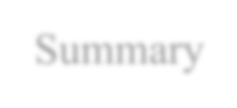
Summary
We have studied:
Trusted Computing
Security Management
Approaches to security risk assessment
Risk treatment alternatives
STRIDE & DREAD Model

Slide 125


